Slide 1
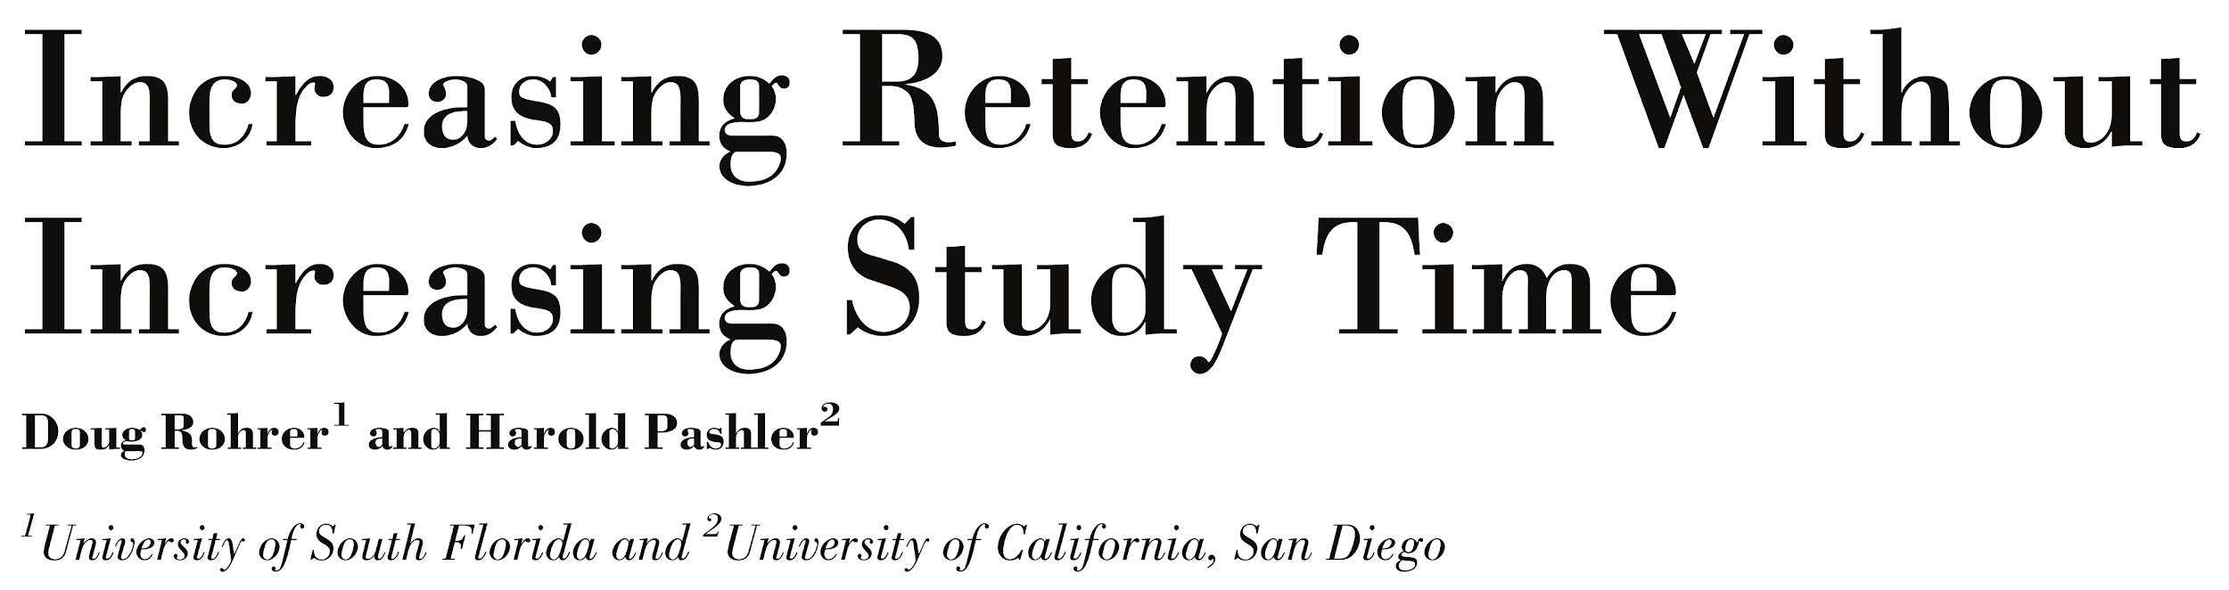
Notes:
Increasing retention without increasing study time is what we all hope to accomplish, and there is actually a way to do it! Rohrer & Pashler’s paper describes a study they did.

Slide 2
The study
Students were taught some math that was unfamiliar to them.
Then split into two groups:
“Spacers” did 2 practice problems, waited a week, and then did 2 more practice problems.
“Massers” did the same 4 practice problems in a single session.
Both groups took a test 1 week after their last practice problem.
How do you think they did?
Notes:
Importantly, the spacers and massers did the same number of problems and spent the same total amount of time.

Slide 3
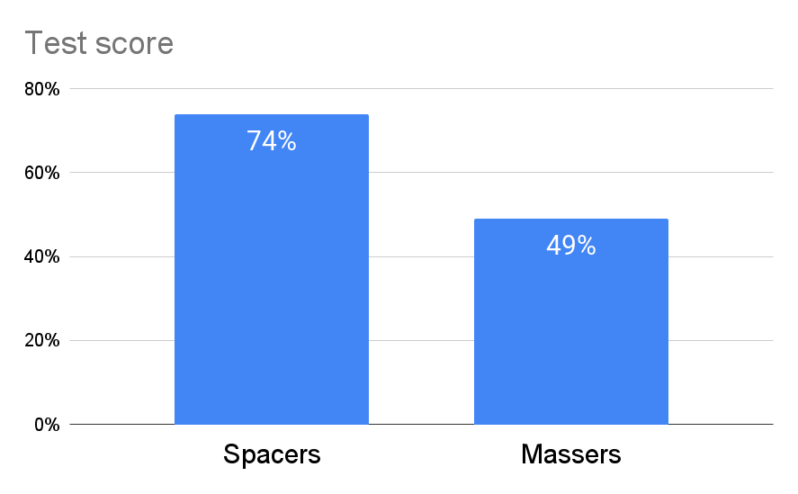
Notes:
Big difference!

Slide 4
This is called the spacing effect: spacing out your practice is more effective than doing it all at once.

Slide 5
Why does it work?
It reduces the rate of forgetting.
When you do massed practice (cramming), you learn something in a short amount of time but forget it just as quickly. (Not so helpful for Math Mb and beyond!)
In spaced practice, you come back to a topic as you’re starting to forget it. This actually triggers your brain to strengthen its memory of that topic!

Slide 6
How does spacing feel?
Challenging! As Make It Stick explains:
“Spacing out your practice feels less productive [than cramming] for the very reason that some forgetting has set in and you’ve got to work harder to recall the concepts.”
“Even in studies where the participants have shown superior results from spaced learning...they believe they learned better on the material where practice was massed.”

Slide 7
The takeaways
Spacing feels harder than cramming.
That difficulty is exactly what makes it more effective! So, don’t give up just because it feels challenging.

Slide 8
How long to wait between practice sessions?
Make It Stick advises:
“enough time so that a little forgetting has set in...but you do not want so much forgetting that [your next session] essentially involves relearning the material”
“Sleep seems to play a large role in memory consolidation, so practice with at least a day in between sessions is good.”

Slide 9
How can you translate this to Math M (or Ec10 or LPSA/LS1a)?
In class:
Recall ideas from the last class at the start of section.
Recall the big ideas of what was just presented at the end of section.
While tackling problem sets:
Start your problem sets the day they are assigned so you have more time to spread out your work.
Splitting assignment completion across two shorter sessions can be better for your long term memory than working in one long session.
If you do finish your homework in one session, spending just 10-15 minutes recalling and reviewing the assignment before the next class can help create longer lasting memory of the material.

